Slide 1
HIGH SCHOOL STUDENTS’ GRADE UNBLOCK
ALEX NGUYEN – a1848722 – 2nd year M. Data Science
GO!

Slide 2



TABLE OF CONTENTS
1
3
EXECUTIVE SUMMARY
RECOMMENDATIONS
2
INSIGHTS

Slide 3
1
EXECUTIVE SUMMARY
SECTION 1
SECTION 2
SECTION 3
SECTION 4

Slide 4
EXECUTIVE SUMMARY
Objectives
Dataset overview & Model selection
Conclusion
Conduct an in-depth exploration of factors influencing students' academic performance and progress.
A diverse range of social, gender, and academic data from high school students.
Use Random Forest Regressor to understand which mostly influences grade.
Failed classes and absences leading to lower grade.

Slide 5
2
INSIGHTS
SECTION 1
SECTION 2
SECTION 3
SECTION 4

Slide 6
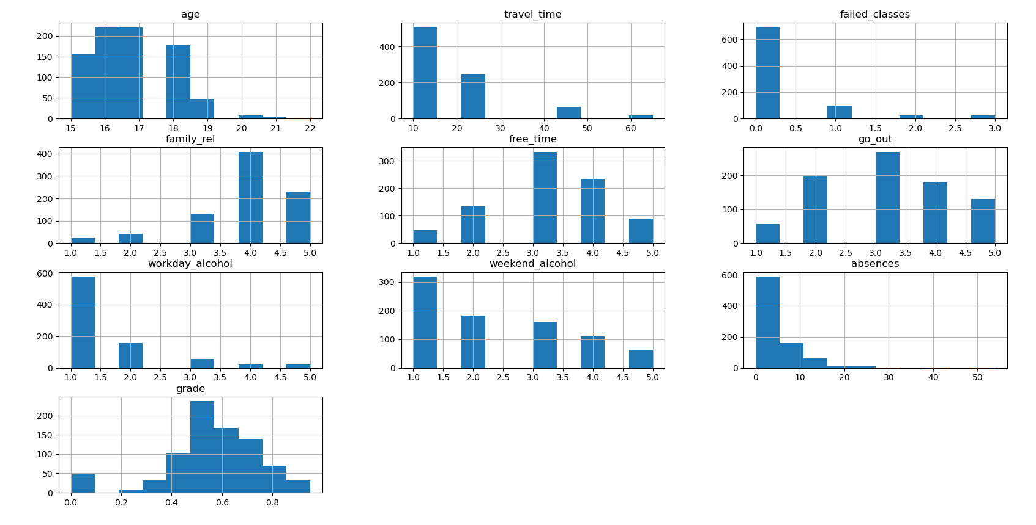
LOOK 1
Primary students:
Never fail any class or absences
Have a good relationship with their family
Travel to school < 20 mins
Have free time after school
Not drink during weekdays or weekends
Grades from 50%

Slide 7
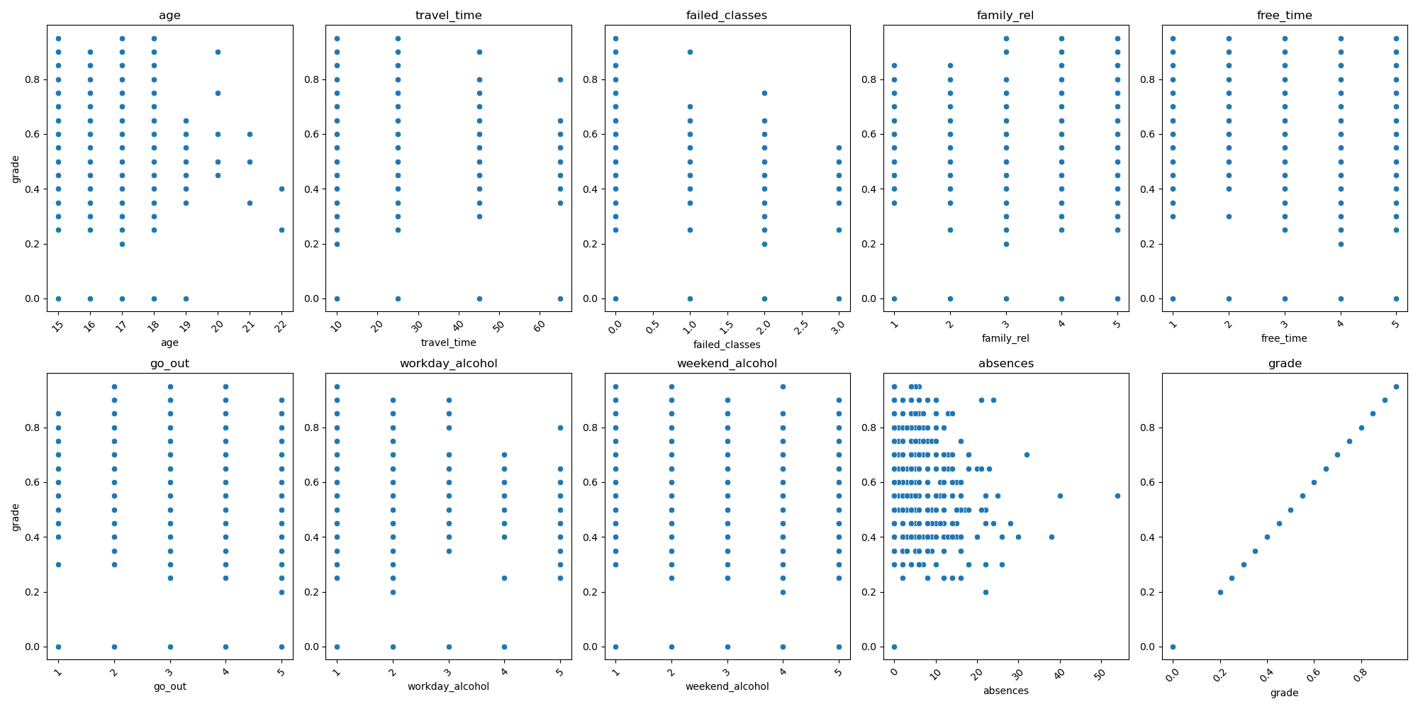
LOOK 2
It seems like absences leading to lower grade

Slide 8
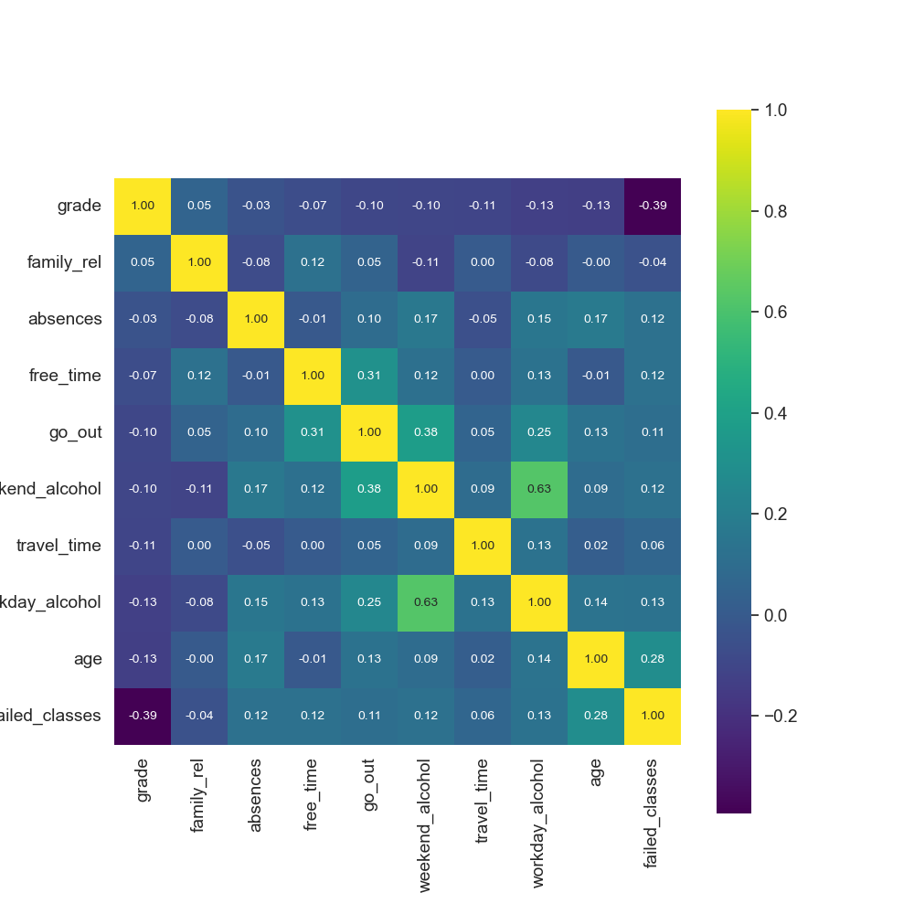
LOOK 3
Besides absences, the rest have less correlation with grades.
Correlation’s not much between numeric variables

Slide 9
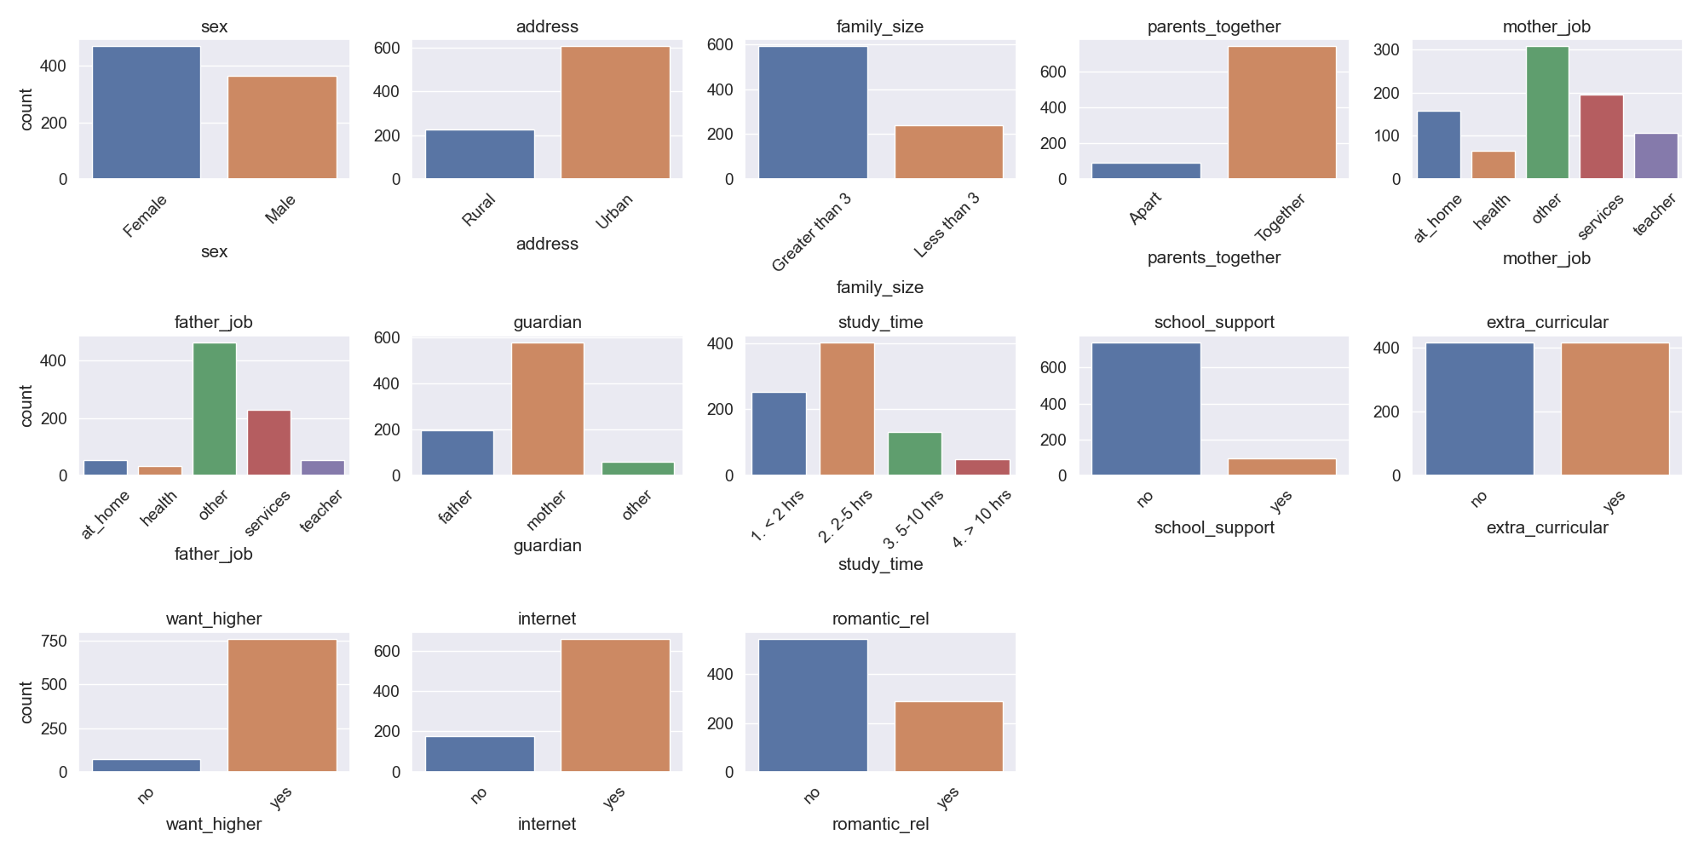
LOOK 4
Primary students in the dataset:
Are female, live in an urban area with access to the Internet
Stay with their parents in a small size household
Study time < 5 hours with no school support
Want to go for higher education

Slide 10
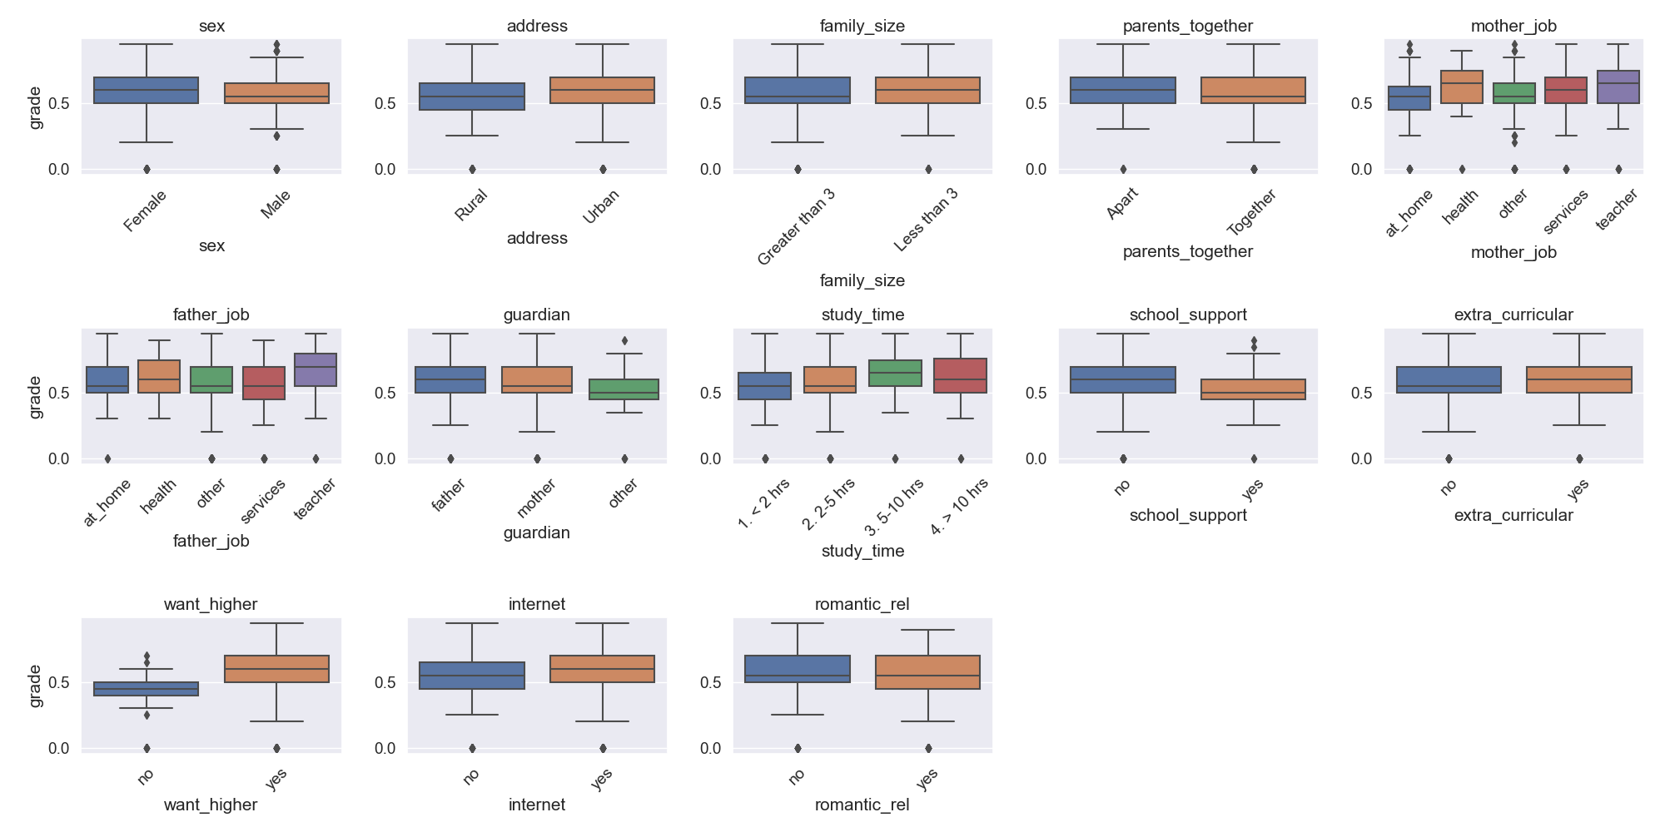
LOOK 5
It seems like the difference in grades impacted by:
Parent job
Has parent as a guardian
Study time and school support
Want to study higher degree

Slide 11
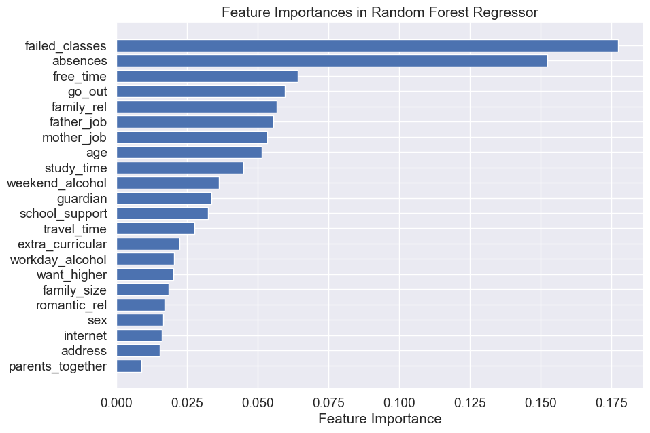
THE REALITY
Random Forest Regressor helps to predict grade with RSME 0.17
The reasons leading to students’ performance are:
Failed classes (17.5%) & absences (15%)
Some minor reasons (4-7%): free time, going out, family relationships, father/mother job, age, study time

Slide 12
3
RECOMMENDATIONS
SECTION 1
SECTION 2
SECTION 3
SECTION 4

Slide 13
What could we help students?
FOCUS ON KEEPING THEIR PACE
Don’t let students fail or skip class
Keep a balance between study time and free time to go out
Check-in with students if any family issues happen

Slide 14
THANKS!

